Slide 1
Data is not always sexy: Food & Beverages in Asheville & Raleigh
Incredible 6: Steve ● Linda ● Michelle ● Amy ● Ed
19 January 2019

Slide 2


The Incredibles
Steve
Linda
Michelle
Amy
Ed
Photo by Andrew Wulf on Unsplash

Slide 3


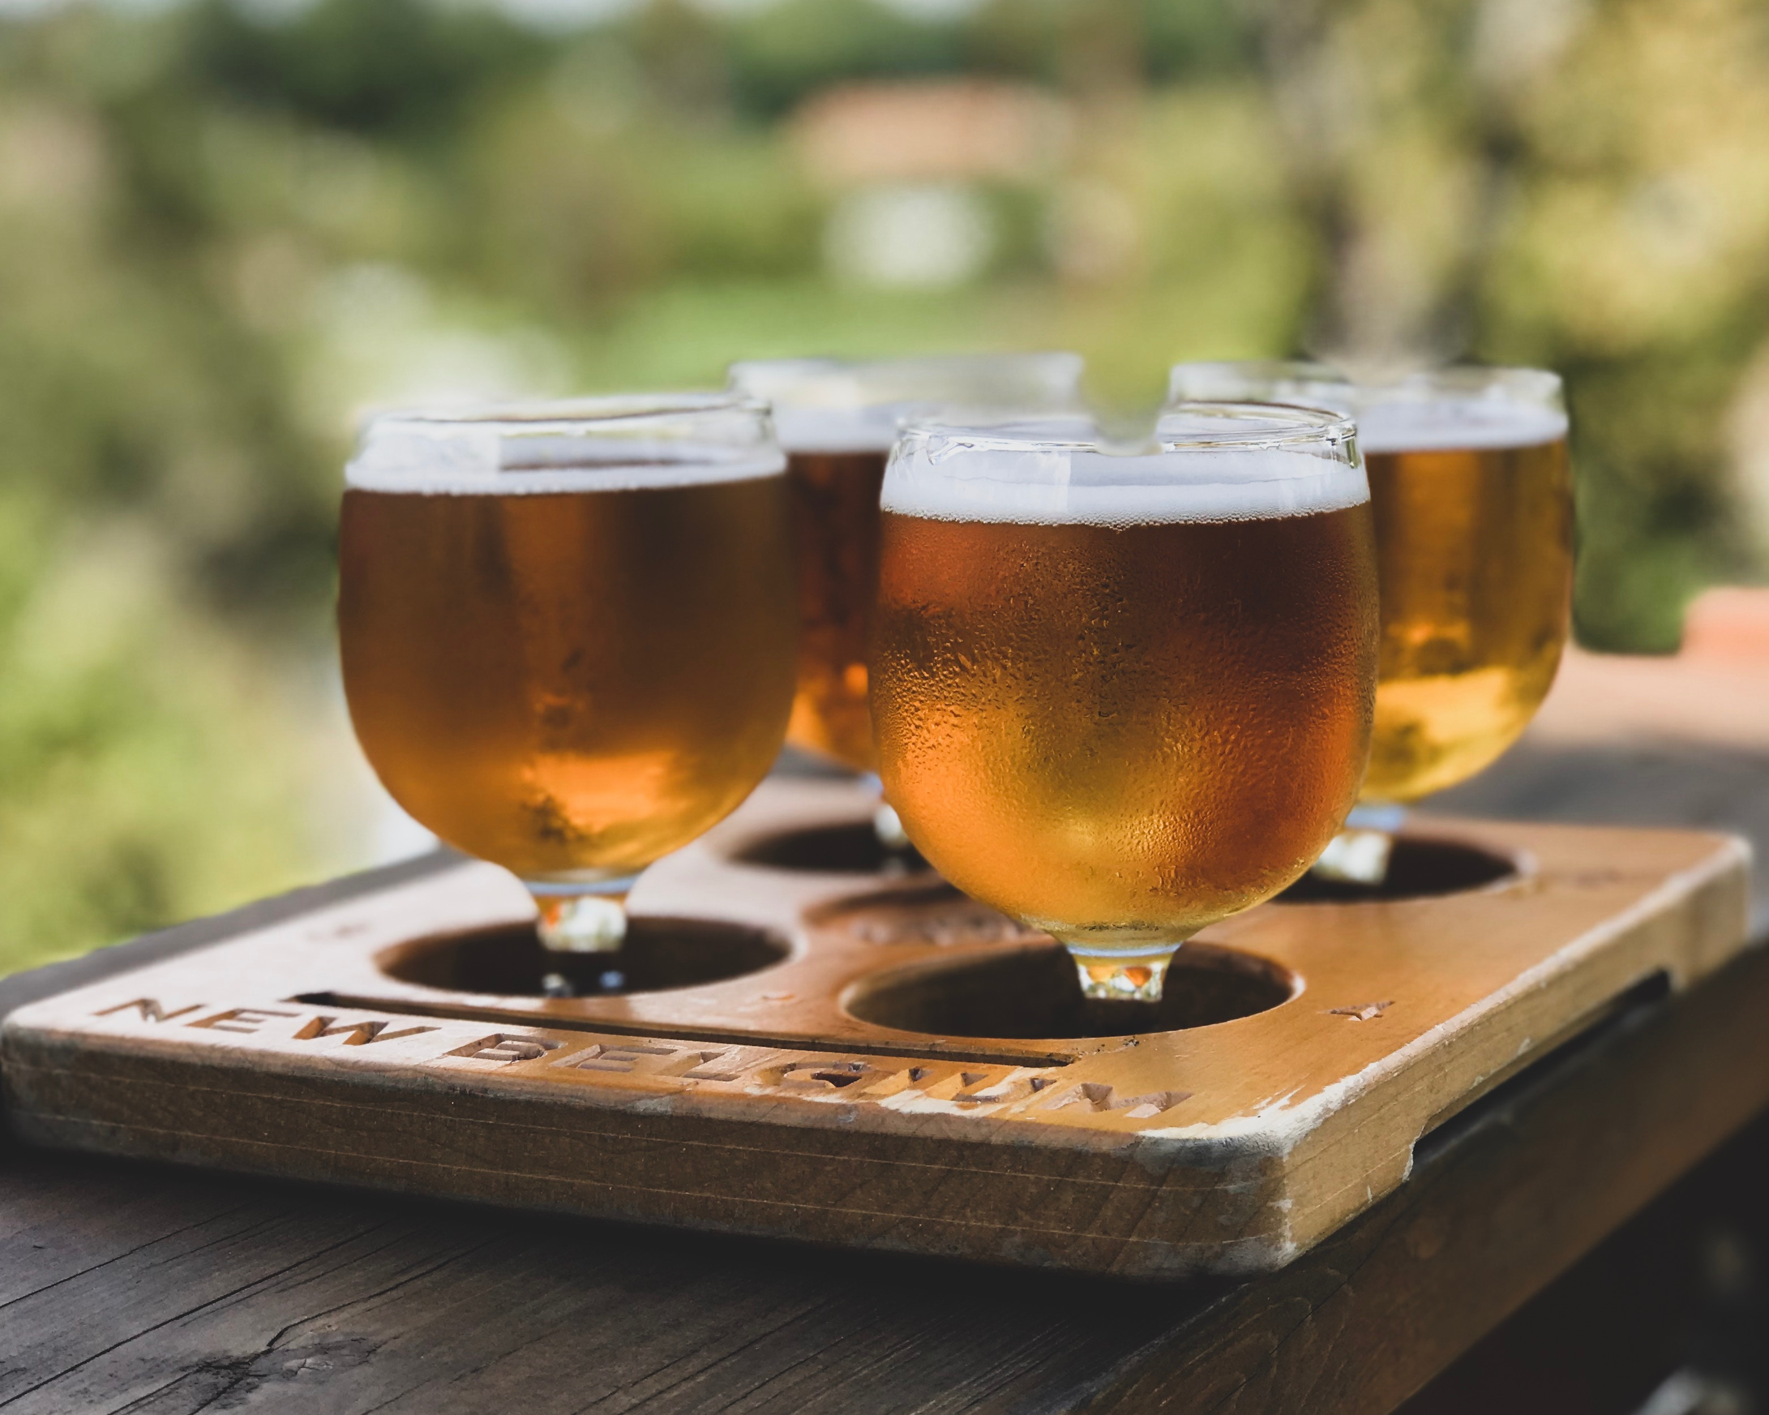
Our apis
Photo by Nathan Dumlao on Unsplash
Photo by Patryk Sobczak on Unsplash
Photo by Josh Duncan on Unsplash

Slide 4
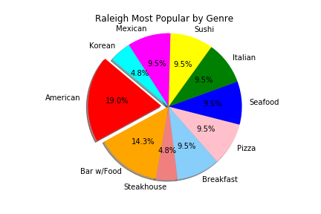
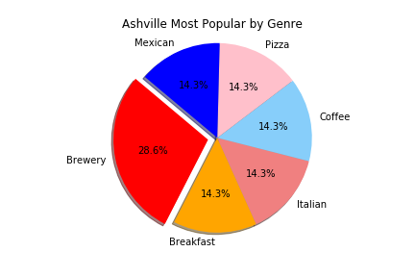
Restaurant findings
Notes:
Each city: restaurants with 5-star rating
Best rated (5-star ratings): review counts (most popular)
Raleigh has more restaurants than Asheville but less 5-star ratings;
Anything with 300+ reviews : most popular
Raleigh many popular ratings, but not 5-star ratings
Each city’s most popular restaurants pie chart of food genres
Location map of most popular and top-rated restaurants (Linda)

Slide 5
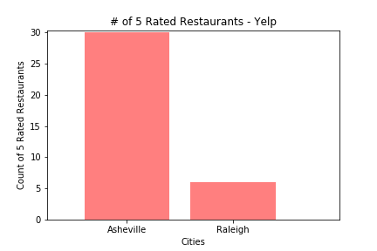
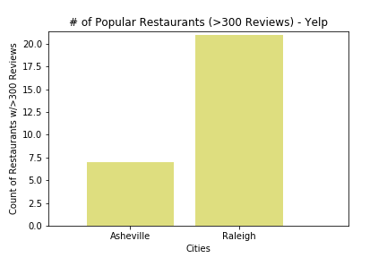
Restaurant findings
Notes:
Each city: restaurants with 5-star rating
Best rated (5-star ratings): review counts (most popular)
Raleigh has more restaurants than Asheville but less 5-star ratings;
Anything with 300+ reviews : most popular
Raleigh many popular ratings, but not 5-star ratings
Each city’s most popular restaurants pie chart of food genres
Location map of most popular and top-rated restaurants (Linda)

Slide 6
Coffee shop findings
Coffee shops in Raleigh & Asheville: total number of ratings
Asheville rates less often than Raleigh
In Asheville: McDonald’s most frequently rated
In Raleigh: Mom & Pop shops more favorably and frequently rated
More Starbucks than McDonalds in Raleigh, the big chains represent ~60% of ratings received, but ratings aren’t high
Photo by Nathan Dumlao on Unsplash

Slide 7
Breweries findings
59 beer establishments in Raleigh; and 40 beer establishments in Asheville
Highest overall rated beer establishment in Asheville: Bruisin’ Ales and Thirsty Monk
Highest overall rated beer establishment in Raleigh: Bottle Revolution
Unclear how many ratings comprised the overall rating score
Photo by Josh Duncan on Unsplash

Slide 8



Process & challenges
Notes:
CollegeAI API: good documentation
Variables expecting: not there
Pivoted and moved forwarded Yelp and Beer Mapping APIs
Difference between the APIs: Yelp → API to CSV since record limit exists; Beer Mapping → constantly pulling from API since no record limit exists
Now what?
Category tags – pulled in a lot of venues that we would not have traditionally thought of as the type of venue we were seeking (restaurants; coffee shops; breweries)
950 records: set limit – what can we look at
CSVs – wanted to keep dataset consistent
Data weaknesses
Deeper review
Debugging errors: Null data; Indentation Error; Syntax Error; Type Error;

